Slide 1
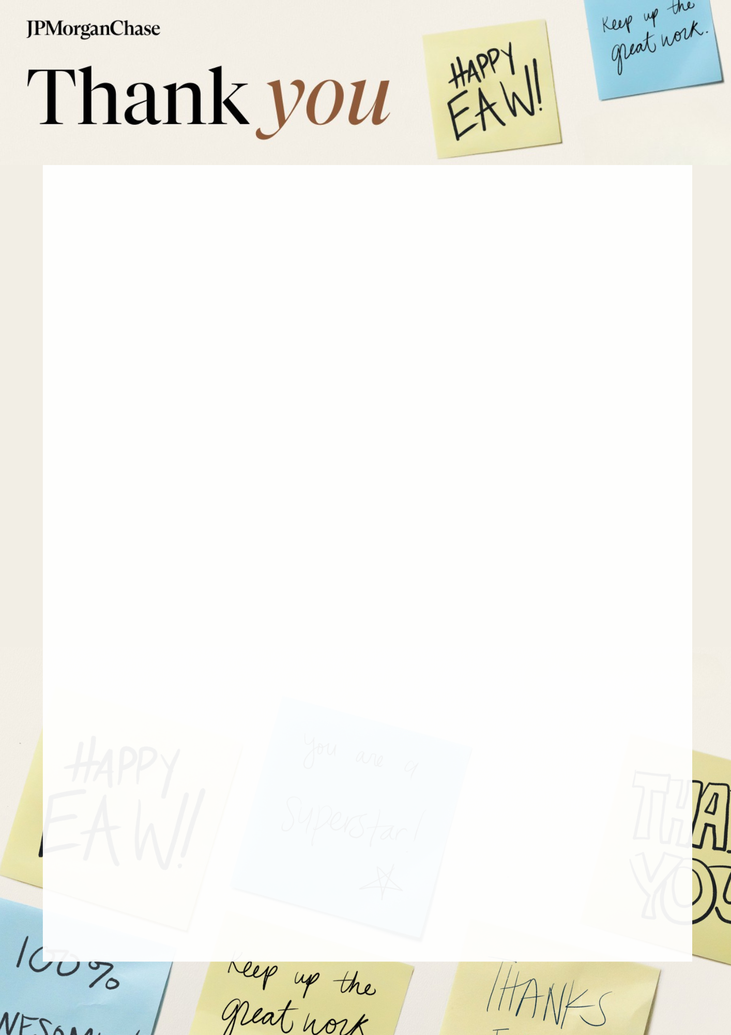
Bank Street EAW Offers
Min 10 people. Available 15th – 19th September only
Please email completed order forms to
bank.street.office.catering@jpmorgan.com
Employee Gifting Medium Sized Groups +20 People
ITEM | QUANTITY | DELIVERY DATE & TIME | DELIVERY LOCATION
Snack with Purpose Gift Box: Selection of 5 Items - from the below. All items are either: Plastic Free, Made in the UK, Minority Owned or Donate to Charity £10.00pp
Wrapped Retro Sweets tin/ jar Approx 200 ind sweets £15.00
Bakery Box 20 assorted items: Brownies, cookies, flapjacks etc. £30.00
Fruit Box 20 Items; apple, banana & Easy peelers £12.00
Donut Box: Basic iced ring doughnuts x 20 (chocolate, strawberry & vanilla) £20.00

Slide 2
Bank Street Catering Offers
Min 10 people. Available 15th – 19th September only
Please email completed order forms to
bank.street.office.catering@jpmorgan.com
Catering Options
ITEM | QUANTITY | DELIVERY DATE & TIME | DELIVERY LOCATION
Breakfast Tea & Coffee with Blueberry & Chocolate Mini Muffins £3.50pp
PM ‘Pick Me Up’ Selection of Granola Bars or Tray Bakes served with Iced Tea £3.50pp
Lunch Selection of Seasonal Sandwiches (1 round per person) Chef’s Choice Mini Sweet Bites Soft Drinks £10pp

Slide 3
Bank Street Employee Gifting Offers
Min 10 people. Available 15th – 19th September only
Please email completed order forms to
bank.street.office.catering@jpmorgan.com
Employee Gifting Large Groups +150 People
ITEM | QUANTITY | DELIVERY DATE & TIME | DELIVERY LOCATION
Flowerpot Muffins
Granola/ Flapjack Bars
Smoothie & Juice Shot Station
Whole Fruit
Donut Worry Doughnuts
Flower & White Bars
Seed & Bean Chocolate Bars
Flawsome Cans
Karma Drinks
Boundless Crisps
Wallaroo Dried Fruit Slices
Olly's Pretzel Thins
Plastic Free Grab & Go Selection
Brave Roasted Pulses
EAW Branded

Slide 4
Bank Street £5 Vouchers
Minimum order for pre-printed vouchers is +20
Please email completed order forms to
bank.street.office.catering@jpmorgan.com
Simply order your vouchers, distribute them to your team, and everyone enjoys a delicious meal from the café. Vouchers can be purchased for £5 Nothing says thank you like a free meal!
In order to maximize flexibility, vouchers can be purchased in multiples of £5 as change is not given. Vouchers are valid at all of our outlets. The expiry date for all vouchers is 31/10/2025.
Please note: the minimum order for pre-printed vouchers is +20, for smaller orders, please request a blank voucher and fill in the fields on the reverse of the voucher.
All vouchers have a minimum lead time of 2 working days, plus postage time where applicable
Voucher Details
Quantity
Authorisation
Local Cost Code:

